Slide 1
Design for Testability Theory and Practice
Lecture 10: DFT and Scan
Definitions
Ad-hoc methods
Scan design
  Design rules
  Scan register
  Scan flip-flops
  Scan test sequences
  Overheads
Boundary scan
Summary

Slide 2
Definitions
Design for testability (DFT) refers to those design techniques that make test generation and test application cost-effective.
DFT methods for digital circuits:
  Ad-hoc methods
  Structured methods:
    Scan
    Partial Scan
    Built-in self-test (BIST)
    Boundary scan
DFT method for mixed-signal circuits:
    Analog test bus

Slide 3
Ad-Hoc DFT Methods
Good design practices learnt through experience are used as guidelines:
    Avoid asynchronous (unclocked) feedback.
    Make flip-flops initializable.
    Avoid redundant gates. Avoid large fanin gates.
    Provide test control for difficult-to-control signals.
    Avoid gated clocks.
    Consider ATE requirements (tristates, etc.)
Design reviews conducted by experts or design auditing tools.
Disadvantages of ad-hoc DFT methods:
    Experts and tools not always available.
    Test generation is often manual with no guarantee of high fault coverage.
    Design iterations may be necessary.

Slide 4
Scan Design
  Circuit is designed using pre-specified design rules.
  Test structure (hardware) is added to the verified design:
    Add a test control (TC) primary input.
    Replace flip-flops by scan flip-flops (SFF) and connect to form one or more shift registers in the test mode.
    Make input/output of each scan shift register controllable/observable from PI/PO.
  Use combinational ATPG to obtain tests for all testable faults in the combinational logic.
  Add shift register tests and convert ATPG tests into scan sequences for use in manufacturing test.

Slide 5
Scan Design Rules
Use only clocked D-type of flip-flops for all state variables.
At least one PI pin must be available for test; more pins, if available, can be used.
All clocks must be controlled from PIs.
Clocks must not feed data inputs of flip-flops.

Slide 6
Correcting a Rule Violation
All clocks must be controlled from PIs.
Comb.
logic
D1
Q
FF
Comb.
logic
D2
CK
Comb.
logic
Q
D1
D2
FF
Comb.
logic
CK

Slide 7
Scan Flip-Flop (SFF)
D
Master latch
Slave latch
TC
Logic
overhead
Q
MUX
SD
Q
CK
D flip-flop
CK
Master open
Slave open
t
TC
Normal mode, D selected
Scan mode, SD selected
t

Slide 8
Level-Sensitive Scan-Design Flip-Flop (LSSD-SFF)
Master latch
Slave latch
D
Q
MCK
Q
SCK
D flip-flop
SD
MCK
Normal
mode
Logic
overhead
TCK
TCK
MCK
Scan
mode
TCK
SCK
t

Slide 9
Adding Scan Structure
PI
PO
Combinational
logic
SFF
SCANOUT
SFF
SFF
TC or TCK
Not shown: CK or
MCK/SCK feed all
SFFs.
SCANIN

Slide 10
Comb. Test Vectors
I1
I2
O1
O2
PI
PO
SCANIN
TC
Combinational
logic
SCANOUT
S1
S2
N1
N2
Next
state
Present
state

Slide 11
Comb. Test Vectors
I1
I2
Don’t care
or random
bits
PI
SCANIN
S1
S2
TC
0 0 0 0 0 0 0 1 0 0 0 0 0 0 0 1 0 0 0 0 0 0 0
O1
O2
PO
SCANOUT
N1
N2
Sequence length = (n_{comb} + 1) n_{sff} + n_{comb} clock periods
n_{comb} = number of combinational vectors
n_{sff} = number of scan flip-flops

Slide 12
Testing Scan Register
Scan register must be tested prior to application of scan test sequences.
A shift sequence 00110011 . . . of length n_{sff} + 4 in scan mode (TC = 0) produces 00, 01, 11 and 10 transitions in all flip-flops and observes the result at SCANOUT output.
Total scan test length: (n_{comb} + 2) n_{sff} + n_{comb} + 4 clock periods.
Example: 2,000 scan flip-flops, 500 comb. vectors, total scan test length ~ 10⁶ clocks.
Multiple scan registers reduce test length.

Slide 13
Multiple Scan Registers
Scan flip-flops can be distributed among any number of shift registers, each having a separate scanin and scanout pin.
Test sequence length is determined by the longest scan shift register.
Just one test control (TC) pin is essential.
PI/SCANIN
PO/
SCANOUT
Combinational
logic
M
U
X
SFF
SFF
SFF
TC
CK

Slide 14
Scan Overheads
IO pins: One pin necessary.
Area overhead:
  Gate overhead = [4 n_{sff}/(n_{g}+10n_{ff})] x 100% where n_{g} = comb. gates; n_{ff} = flip-flops Example – n_{g} = 100k gates, n_{ff} = 2k flip-flops overhead = 6.7%.
  More accurate estimate must consider scan wiring and layout area.
Performance overhead:
  Multiplexer delay added in combinational path; approx. two gate-delays.
  Flip-flop output loading due to one additional fanout; approx. 5 - 6%.

Slide 15
Hierarchical Scan
Scan flip-flops are chained within subnetworks before chaining subnetworks.
Advantages:
    Automatic scan insertion in netlist
    Circuit hierarchy preserved – helps in debugging and design changes
Disadvantage: Non-optimum chip layout.
Scanin
Scanout
SFF1
SFF4
SFF1
SFF3
Scanin
Scanout
SFF2
SFF3
SFF4
SFF2
Hierarchical netlist
Flat layout

Slide 16
Optimum Scan Layout
X
X’
IO
pad
SFF
cell
SCANIN
Flip-
flop
cell
Y
Y’
TC
SCAN
OUT
Routing
channels
Interconnects
Active areas: XY and X’Y’

Slide 17
Scan Area Overhead
Linear dimensions of active area:
X = (C + S) / r
X’ = (C + S + αS) / r
Y’ = Y + ry = Y + Y(1--β) / T
Area overhead
X’Y’--XY
= -------------- x 100%
XY
1--β
= [(1+αs)(1+ -------) – 1] x 100%
T
1--β
= (αs + ------- ) x 100%
T
y = track dimension, wire
width+separation
C = total comb. cell width
S = total non-scan FF cell
width
s = fractional FF cell area
= S/(C+S)
α = SFF cell width fractional
increase
r = number of cell rows
or routing channels
β = routing fraction in active
area
T = cell height in track
dimension y

Slide 18
Example: Scan Layout
2,000-gate CMOS chip
Fractional area under flip-flop cells, s = 0.478
Scan flip-flop (SFF) cell width increase, α = 0.25
Routing area fraction, β = 0.471
Cell height in routing tracks, T = 10
Calculated overhead = 17.24%
Actual measured data:
Scan implementation Area overhead Normalized clock rate
______________________________________________________________________
None 0.0 1.00
Hierarchical 16.93% 0.87
Optimum layout 11.90% 0.91

Slide 19
ATPG Example: S5378
Original
2,781
179
0
0.0%
4,603
35/49
70.0%
70.9%
5,533 s
414
414
Full-scan
2,781
0
179
15.66%
4,603
214/228
99.1%
100.0%
5 s
585
105,662
Number of combinational gates
Number of non-scan flip-flops (10 gates each)
Number of scan flip-flops (14 gates each)
Gate overhead
Number of faults
PI/PO for ATPG
Fault coverage
Fault efficiency
CPU time on SUN Ultra II, 200MHz processor
Number of ATPG vectors
Scan sequence length

Slide 20
Boundary Scan (BS)
IEEE 1149.1 Standard
Developed for testing chips on a printed circuit board (PCB).
A chip with BS can be accessed for test from the edge connector of PCB.
BS hardware added to chip:
  Test Access port (TAP) added
    Four test pins
    A test controller FSM
  A scan flip-flop added to each I/O pin.
Standard is also known as JTAG (Joint Test Action Group) standard.

Slide 21
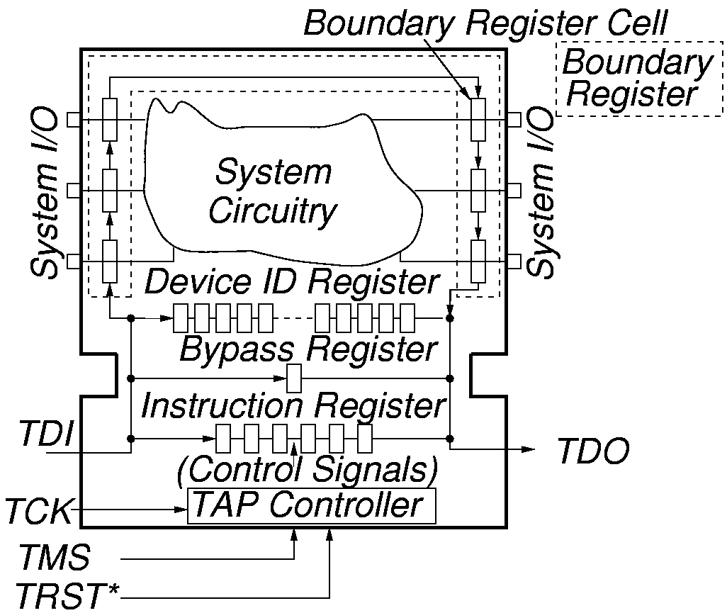
Boundary Scan Test Logic

Slide 22
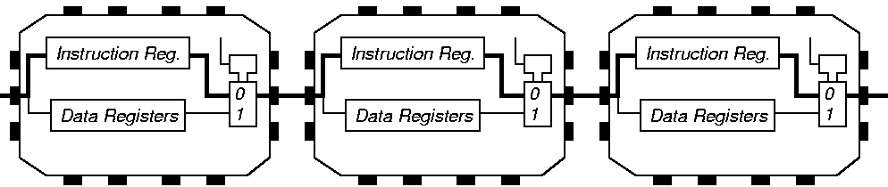
Instruction Register Loading

Slide 23
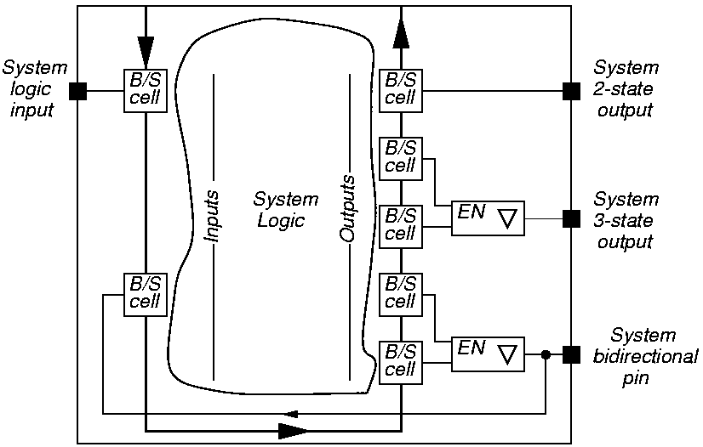
System View of Interconnect

Slide 24
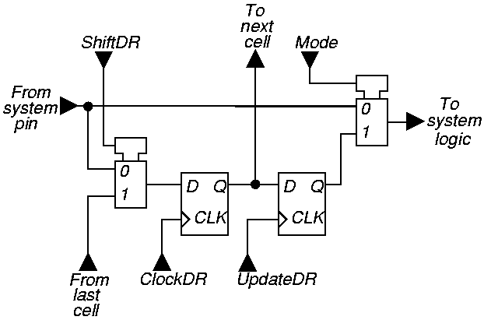
Elementary Boundary Scan Cell

Slide 25
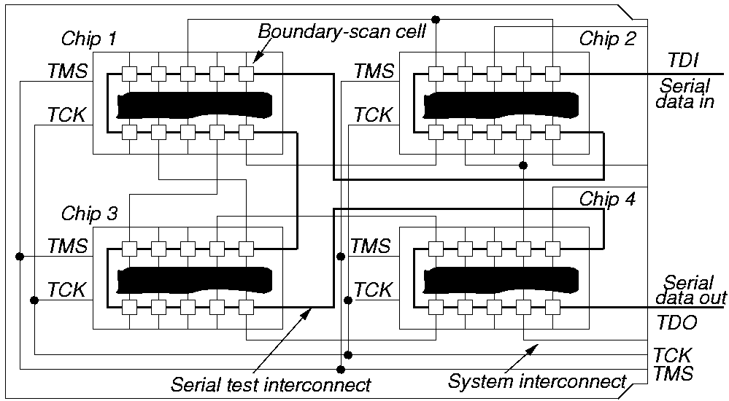
Serial Boundary Scan
PCB or
MCM
Edge connector
Other implementations: 1. Parallel scan, 2. Multiple scans.

Slide 26
Summary
Scan is the most popular DFT technique:
    Rule-based design
    Automated DFT hardware insertion
    Combinational ATPG
Advantages:
    Design automation
    High fault coverage; helpful in diagnosis
    Hierarchical – scan-testable modules are easily combined into large scan-testable systems
    Moderate area (~10%) and speed (~5%) overheads
Disadvantages:
    Large test data volume and long test time
    Basically a slow speed (DC) test
Variations of scan:
    Partial scan
    Random access scan (RAS)
    Boundary scan (BS)

Slide 27
Exercise 4: Lecture 10
What is the main advantage of scan method?
Given that the critical path delay of a circuit is 800ps and the scan multiplexer adds a delay of 200ps, determine the performance penalty of scan as percentage reduction in the clock frequency. Assume 20% margin for the clock period and no delay due to the extra fanout of flip-flop outputs.
How will you reduce the test time of a scan circuit by a factor of 10?

Slide 28
Exercise 4 Answers
What is the main advantage of scan method?
Only combinational ATPG (with lower complexity) is used.
Given that the critical path delay of a circuit is 800ps and the scan multiplexer adds a delay of 200ps, determine the performance penalty of scan as percentage reduction in the clock frequency. Assume 20% margin for the clock period and no delay due to the extra fanout of flip-flop outputs.
Clock period of pre-scan circuit = 800+160 = 960ps
Clock period for scan circuit = 800+200+200 = 1200ps
Clock frequency reduction = 100×(1200-960)/1200 = 20%
How will you reduce the test time of a scan circuit by a factor of 10?
Form 10 scan registers, each having 1/10th the length of a single scan register.

